Slide 1
Planar microstrip series-fed array for 5G applications with beamforming capabilities
報告人:109368085 臧英宏
Tiago Varum, Amélia Ramos & João N. Matos (2018). Planar microstrip series-fed array for 5G applications with beamforming capabilities. Paper presented at the 2018 IEEE MTT-S International Microwave Workshop Series on 5G Hardware and System

Slide 2
Outline
Introduction
Propose Method
Experimental Results
Conclusion

Slide 3
1
Introduction

Slide 4
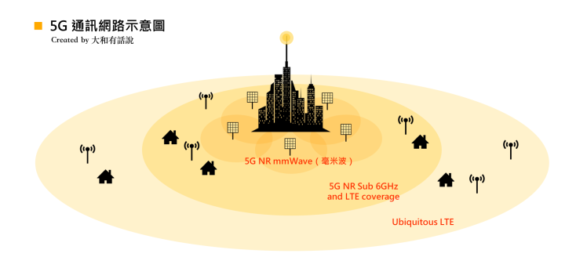
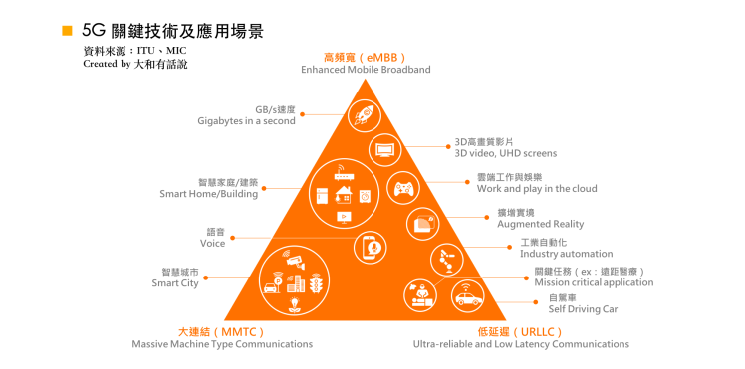
Introduction
The world is going through the era of communications emerging everyday new features and applications, connecting people and objects. The amount of consumed data grows more and more, together with the expectations of an increasingly technological society, smarter and better services.

Slide 5
new challenges of 5G
To meet the new challenges of 5G communications, and to allow spatial filtering, beamforming, as well as a greater coverage, the use of adaptive antenna arrays are needed, with the ability to direct its radiation shape (beamforming)

Slide 6
2
Propose Method

Slide 7
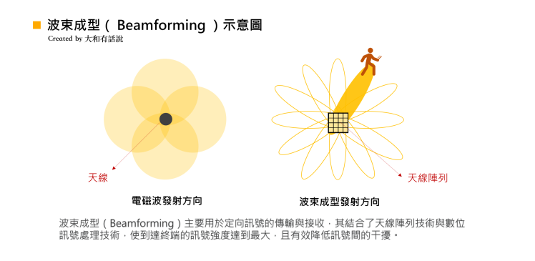
beamforming
波束成形（Beamforming），是一種透過「天線陣列」定向發送和接收訊號的技術，其透過在特定方向上發射或接收訊號的疊加，將既有的全向覆蓋，轉換為精準的指向性傳輸，不僅延長了傳送距離，也大幅減少訊號的干擾。
其利用空間資源進行訊號品質提升、干擾抑制或消除及適應性波束調整的機制，近年來已被廣泛的應用在無線通訊。智慧型天線系統利用天線增益以提升訊號雜訊比，而對抗無線通道的多路徑衰落現象，亦可使用天線陣列來進行空間分集。

Slide 8
Antenna structure and design
in this work was assumed a linear array of N=4 elements arranged along the x plane, as shown in the Fig. a). Taking into account the radiation characteristics, especially the sidelobe level and the half power beamwidth (HPBW), and the dimensions of the modular structure, the distance between the elements was set d=0.75λ.
In order to achieve higher gains, to contribute to a better communication performance, and all the benefits proposed by the 5G networks, each of the N elements rather than a single antenna were considered to be a higher gain radiating structure, an subarray of M=4 elements, as shown in Fig b)
Notes:
波束成型（Beamforming），是一種透過「天線陣列」定向發送和接收訊號的技術，其透過在特定方向上發射或接收訊號的疊加，將既有的全向覆蓋，轉換為精準的指向性傳輸，不僅延長了傳送距離，也大幅減少訊號的干擾。

Slide 9
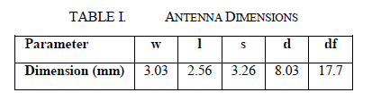
Antenna structure and design
To connect all the M subarray elements so they are fed in phase, the series feed technique [4] was used since it is a simple and compact solution (with lower losses) for the feeding of antenna arrays as compared with other alternatives. In this feed configuration, the edges of the various microstrip patches are connected by half-guided wavelength microstrip line sections.
to individually connect each of the N subarrays, considering the physical size of the connectors relative to the overall size of the antennas, extensions of microstrip lines were created

Slide 10
3
Experimental Results

Slide 11
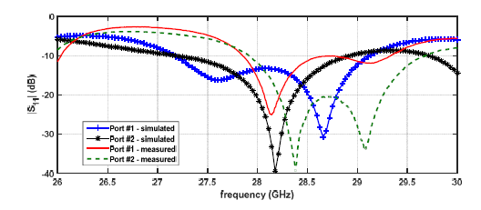
Simulation result
This figure presents the comparison between the simulated and measured S11 of the antenna array. Since the array is symmetrical, in the figure it is just shown the results for the ports #1 and #2 (#1 & #4 and #2 & #4 are equal respectively). Both simulated and measured curves present acceptable results with more than 1.5GHz bandwidth (assuming the criteria of S11<10dB) although there’s a small shift in the measured S11 of port #2
Fig. Simulated and measured reflection coefficient of the antenna array

Slide 12

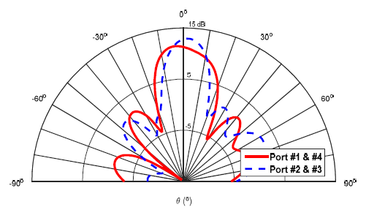
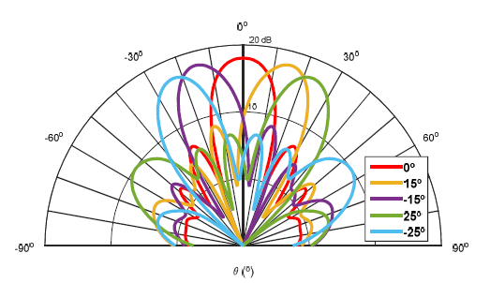
Simulation result
θ_{i} : direction in which the maximum of the radiation diagram is to be oriented
d : distance between elements
β : the phase constant
Simulated radiation pattern (y-plane) of each subarray of M = 4 series fed patch antennas
Simulated radiation pattern (x-plane) of each subarray of N = 4 antenna array with the applied weights

Slide 13
4
Conclusion

Slide 14
Conclusion and acknowledgment
A 4×4 planar microstrip antenna array has been developed to operate in the 5G networks at 28GHz. This antenna has a considerable bandwidth over 1.5GHz and gain about 18dBi, and is presented as a solution for beamforming application scenarios. Moreover, it has small dimensions and a modular structure that can be easily scalable for a greater number of ports and elements.
This work is supported by the European Regional Development Fund (FEDER), through the Competitiveness and Internationalization Operational Programme (COMPETE 2020 ) of the Portugal 2020 framwork, Project, RETIOT, PCCI-01-0145-FEDER-01643

Slide 15
Q&A
THANKS FOR YOUR WATCHING

